Slide 1

Airline Metrics
Evan Edmunds

Slide 2
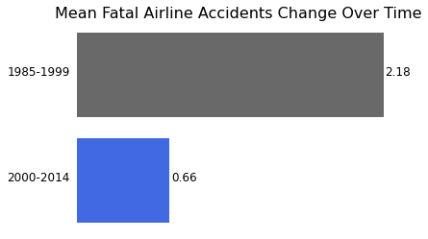
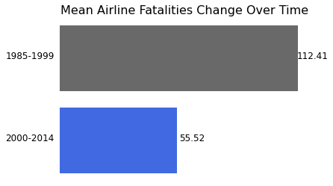
Aircraft Danger, Now and Then
There is a noticeable decrease in the mean number of fatalities and fatal accidents across airlines worldwide.

Slide 3
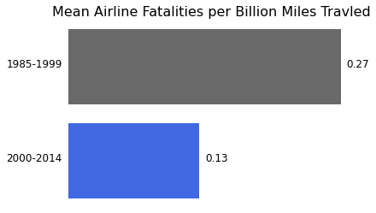
Aircraft Fatailities Standardized by Distance
Even when accounting for the total distance travelled, there is a noticeable decrease in mean airline fatalities across airlines, world-wide.

Slide 4
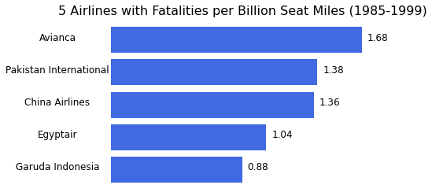
5 Deadliest Airlines (1985-1999)
From the period of 1985 – 1999, these five international airlines had the most fatalities per billion miles travelled.

Slide 5
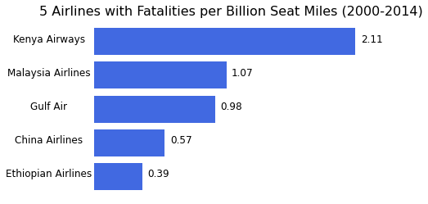
5 Deadliest Airlines (2000-2014)
Most of the values are reduced since 1985 – 1999.
Kenya Airways is the notable exception, having a higher fatality rate than any other country across both time periods.

Slide 6
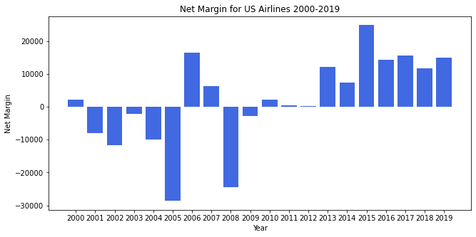
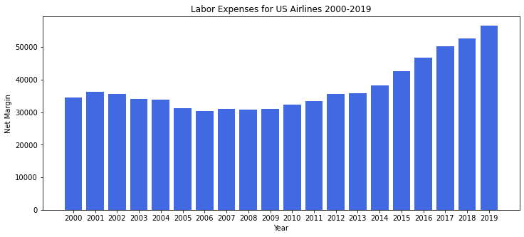
Concerning Domestic Affairs
In the past 5 years, the net margin has remained consistent, while the labor expenses have been steadily increasing.
This will need to be closely monitored if we are to implement additional safety procedures.

